Slide 1

SDM COLLEGE OF ENGINEERING AND TECHNOLOGY, DHARWAD - 580002
(An Autonomous Institution affiliated to Visvesvaraya Technical University, Belgaum, 590018)
Department of Artificial Intelligence and Machine Learning
MINOR PROJECT
“IoT Network Intrusion Detection Systems (IDS) using AI&ML Techniques”
UNDER THE GUIDANCE OF: Dr. R.N.YADAWAD
TEAM MEMBERS:
K N NIVEDH - 2SD22AI027
SHIVASHANTVEER R N - 2SD22AI053
SIDDHALING S PADANUR - 2SD22AI057
SINCHANA HIREMATH - 2SD22AI059
SUDEV BASTI - 2SD22AI060

Slide 2
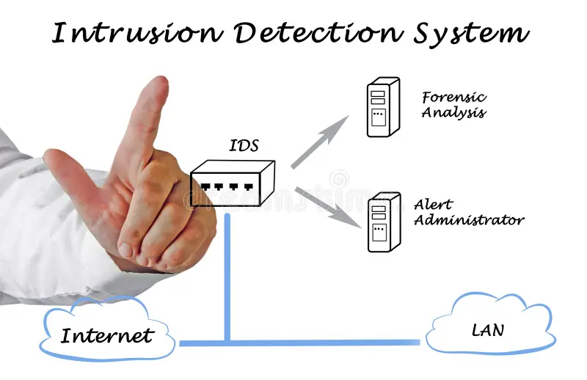
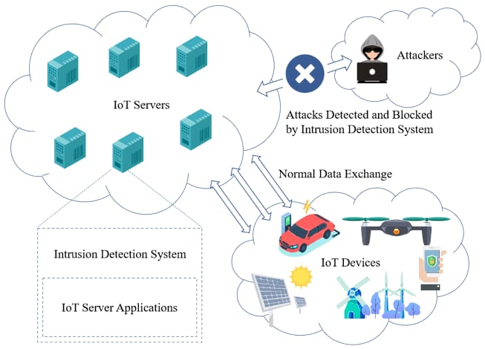
IoT Network Intrusion Detection System Using AI&ML Techniques

Slide 3
Agenda
Introduction
Field of Project
Objectives
Methodology
Technology Used
Architecture
Datasets - Description
Applications and Advantages
Summary
Conclusion
References

Slide 4
Introduction
Project Overview
The proposed project aims to develop an IoT Network Intrusion Detection System (IDS) using AI&ML techniques. With IoT devices becoming integral to industries like healthcare, smart homes, and manufacturing, ensuring security against cyber threats has become critical.
Real-Time Example
A smart home system hacked to control devices like locks and cameras.
Industrial IoT systems targeted by malware, leading to production halts.
Purpose
Detect malicious activities in IoT networks.
Enhance the reliability and security of IoT environments.

Slide 5
Field of Project
Domain
Cybersecurity and Network Protection with the focus on IoT environments.
Goal
Protect IIoT networks by analyzing traffic, identifying vulnerabilities, and detecting suspicious activities.

Slide 6
Objectives
Provide a robust solution for IoT network security :
Develop an adaptable and efficient system capable of safeguarding IoT networks against evolving threats.
Achieve real-time detection of malicious activities :
Enable immediate identification and response to malicious activities, reducing potential harm
Prevent threats using AI/ML techniques :
Utilize AI/ML techniques such as supervised learning for signature-based attacks and unsupervised learning for detecting anomalies and Zero-Day threats.

Slide 7
Methodology
Problem Definition :- Identify IoT network threats and collect relevant data.
Data Preprocessing :- Clean and normalize data, extract relevant features.
Model Training :- Supervised learning for known threats
Evaluation and Testing :- Assess model accuracy and optimize for better results.
Implementation :- Integrate IDS into IoT networks with real-time monitoring.

Slide 8
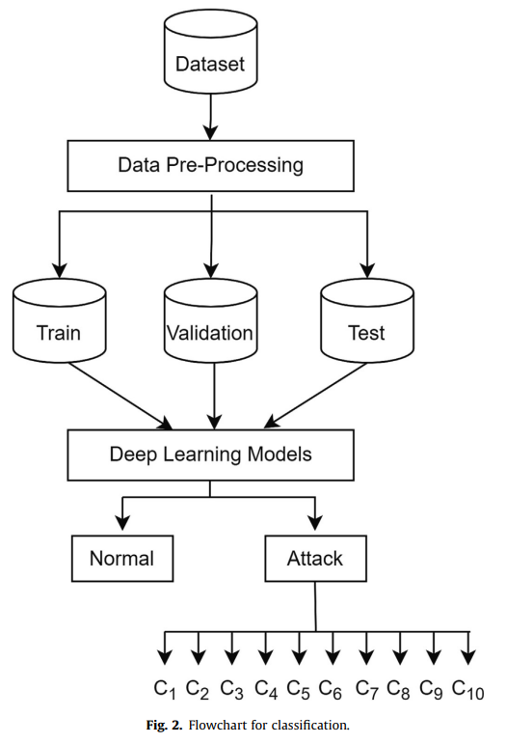

Slide 9
Technology Used
IoT: Network of devices and sensors exchanging data.
Intrusion Detection System (IDS): Monitors and detects malicious activities.
AI:
Deep Learning: CNN (Convolutional Neural Network) and LSTM (Long Short-Term Memory) for intrusion detection.
Supervised Learning: Classification using labeled data (normal and attack categories).
ML:
Supervised Learning: Classification with labeled data (normal and attack categories).
Feature Scaling: MinMaxScaler for preprocessing.
Data Encoding: LabelEncoder for categorical data transformation.

Slide 10
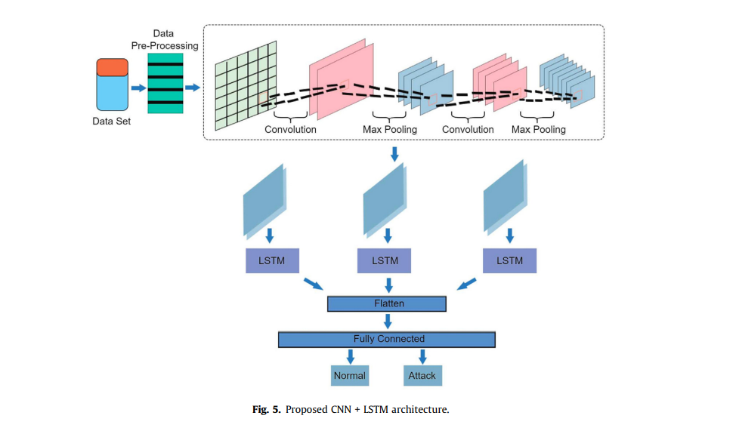
Architecture
Input Layer:
Accepts preprocessed network traffic features
as a time-series tensor.
Convolutional Layers (CNN):
Extract spatial features from network traffic data.
Apply multiple filters to capture patterns in traffic behavior.
Pooling Layers:
Reduce dimensionality while retaining important features.
Recurrent Layers (LSTM):
Model temporal dependencies and sequential patterns in the
network traffic.
Identify anomalies over time.

Slide 11
Datasets and Attributes
Dataset:
KDD Cup 1999 or a simulated IoT traffic dataset.
Key Features:
42 attributes like duration, protocol type, and flag.
Labels:
Normal, DoS, U2R, R2L attacks.

Slide 12
Applications and Advantages
Applications (industrial IoT systems):
Industrial Process Monitoring
Predictive Maintenance Security
Smart Energy Grids
Supply Chain Security
Advantages:
Enhanced Detection Accuracy
Automation and Efficiency
Handling Anomalous Data
Adaptability to Dynamic Environments

Slide 13
Summary
Purpose: The system is designed to monitor network traffic for potential intrusions, providing real-time detection and response to threats faced by IIoT devices.
Architecture:
CNN: Used for feature extraction, identifying spatial patterns in network data.
LSTM: Handles temporal data, recognizing trends and changes over time in network behavior.
Advantages:
Enhanced detection accuracy through the integration of spatial and temporal analysis.
Real-time threat detection and automated analysis, improving efficiency and reducing manual monitoring.
Applications:
Provides real-time monitoring, automated incident response, historical analysis, and insights into long-term trends in network security.

Slide 14
Conclusion
Effective Threat Detection: A CNN-LSTM-based NIDS combines the strengths of CNNs for feature extraction and LSTMs for sequential data analysis, enabling accurate detection of complex intrusion patterns in Industrial IoT environments
Suitability for IIoT: This approach addresses the unique challenges of IIoT, including high data volume and diverse device interactions, making it ideal for securing critical industrial systems.
Real-Time Security: By processing network traffic efficiently, it enables real-time detection and mitigation of cyber threats, reducing potential damage and ensuring system reliability.
Challenges and Opportunities: While computational overhead and the need for quality datasets remain hurdles, this hybrid model holds great promise for enhancing the cybersecurity of IIoT networks.

Slide 15
References
1. Alrawashdeh, K., & Purdy, C. (2016). "Toward an Online Anomaly Intrusion Detection System Based on Deep Learning."
2. Xiao, L., et al. (2018). "IoT Security Techniques Based on Machine Learning."
3. Mirsky, Y., et al. (2018). "Kitsune: An Ensemble of Autoencoders for Online Network Intrusion Detection."
4. Roman, R., et al. (2013). "On the Features and Challenges of Security in IoT.“
5. Sharafaldin, I., et al. (2024): Introduces CICIoT2023, a new IoT dataset, and applies ML techniques for real-time network intrusion detection.
6. He, Y., et al. (2024): Explores federated learning to improve privacy in distributed IoT intrusion detection systems.
7. Tariq, N., et al. (2023): Proposes a hybrid deep learning model combining CNN and LSTM for efficient IoT intrusion detection.
8. Ali, A., et al. (2023): Discusses a GAN-based approach for anomaly detection in IoT networks to handle imbalanced datasets.

